Slide 1

Development Of A Android Application To Help Cancer Patients
Submitted By –
Akshat Maurya (2004310100013)
Krishna Kumar (2004310100041)
Sachin Singh (2004310100067)
Prince kr .Pandey (2004310100058)
Submitted To-
Ms. Neha Goyal
(Assistant Professor)

Slide 2
Content
Introduction
Overview
Literature Survey
Software Used
Block Diagram
Implementation
Database Schema
Snapshots
Conclusion
References

Slide 3
OVERVIEW:
What is Android?
Android is an open source and Linux-based Operating System for mobile devices such as smartphones and tablet computers.
The first beta version of the Android Software Development Kit (SDK) was
released by Google in 2007 where as the first commercial version,
Fun Fact about Android:
Google OS are always named after sweet, like Cupcake, KitKat, Donut,
Nougat, Lollipop, etc. A Google spokesperson once said, “Android
powers over the 1 billion smartphones and tablets. Since these
devices make our lives so sweet, each android version is named after
a dessert”.

Slide 4
Technology Used:
Front End: XML
Android Software Development Kit(SDK):
Android SDK stands for Android Software Development Kit which is developed by Google for Android Platform. With the help of SDK, we can create Android Apps easily.
Android SDK is compatible with all operating systems such as Windows, Linux, macOS, etc.
JAVA Development Kit(JDK):
When you write a program in Java for Android and click a button, your code is transformed into another form understood by Android.
Technology Used:
Front End: XML
Backend: JAVA

Slide 5
OBJECTIVE
The objective of this project is to develop a multi platform where patient can keep a track of the side effects occurring due to various cancer
They can view remedy for these side effects
They can also respond by filling feedback form which doctor can view

Slide 6
Implementation:
Modules:
Admin Module:
Create and manage hospital staffs and Doctors
Manage Static data
Staff Module:
Create and Manage Patients data
Doctor Module:
Monitor Patients activity
Patient Module:
Check for Side effect remedies
Review Side effect Remedies

Slide 7
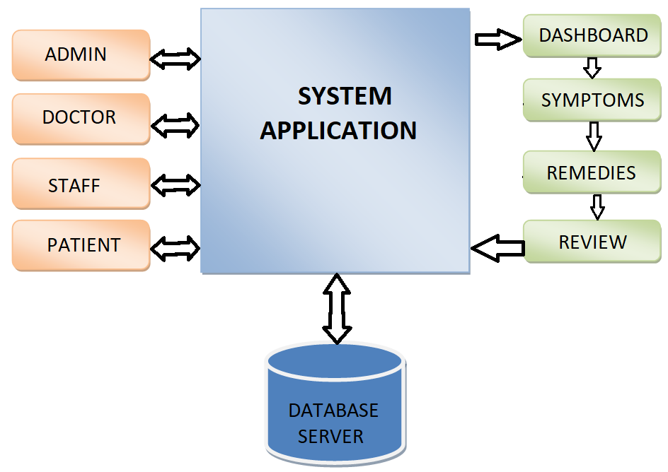
Block Diagram:

Slide 8
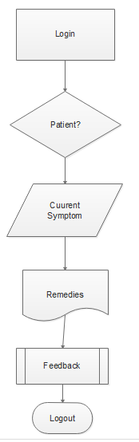
Data flow Chart:

Slide 9
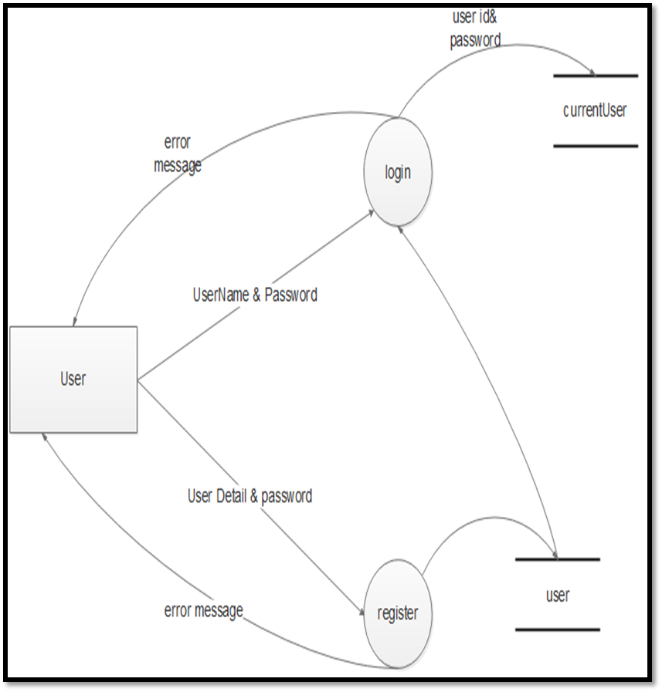
DATA FLOW DIAGRAM :

Slide 10
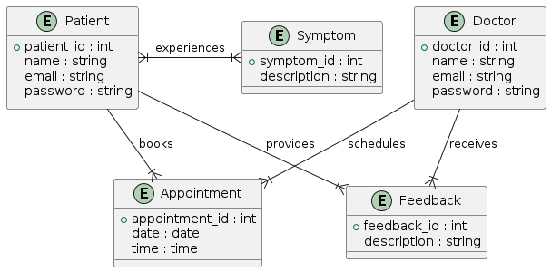
E-R DIAGRAM :

Slide 11
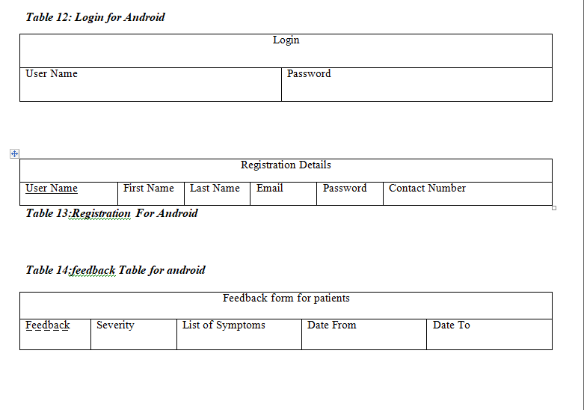
Database Schema: Android

Slide 12
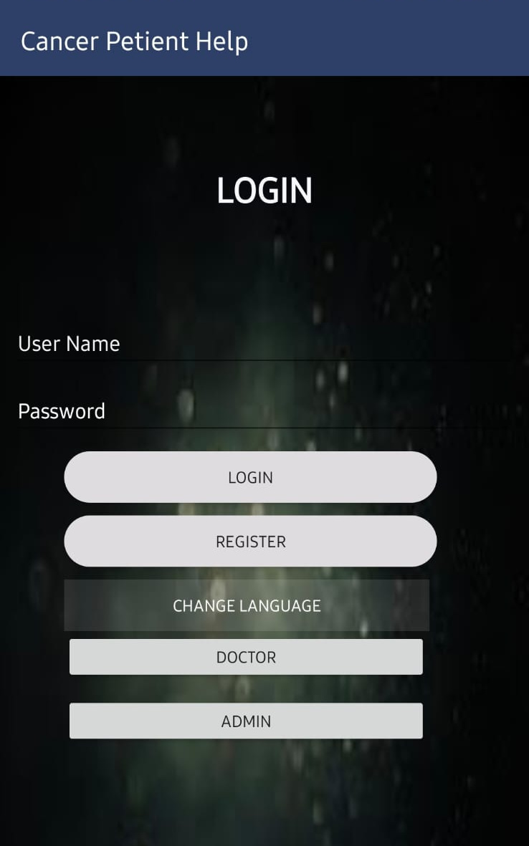
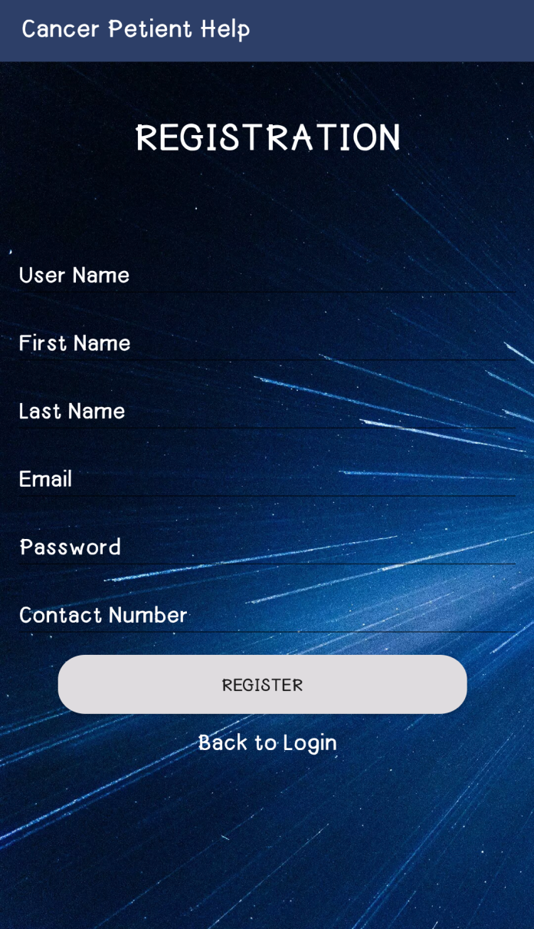
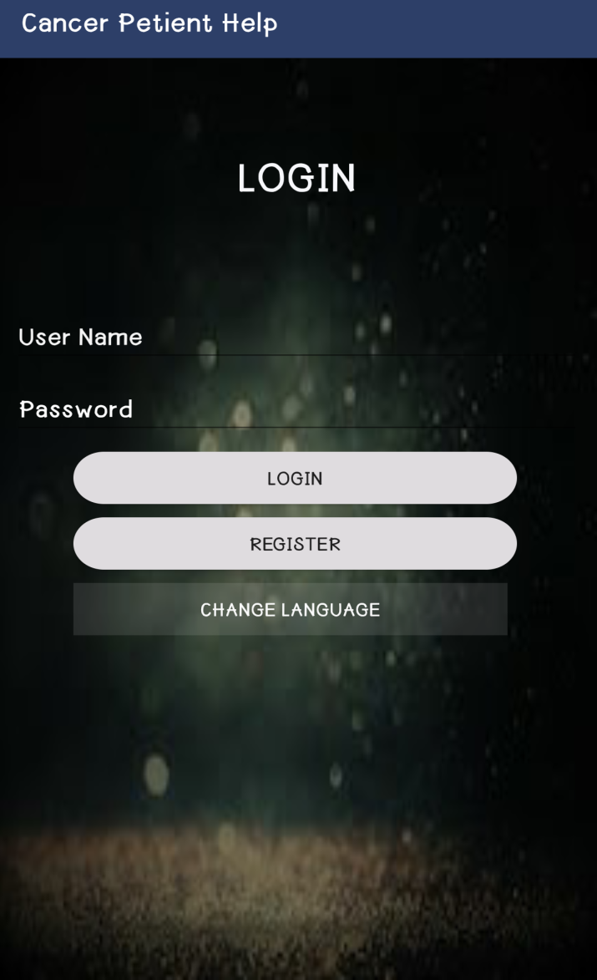
Snapshots : 1. Android App :
Login ID
Password

Slide 13
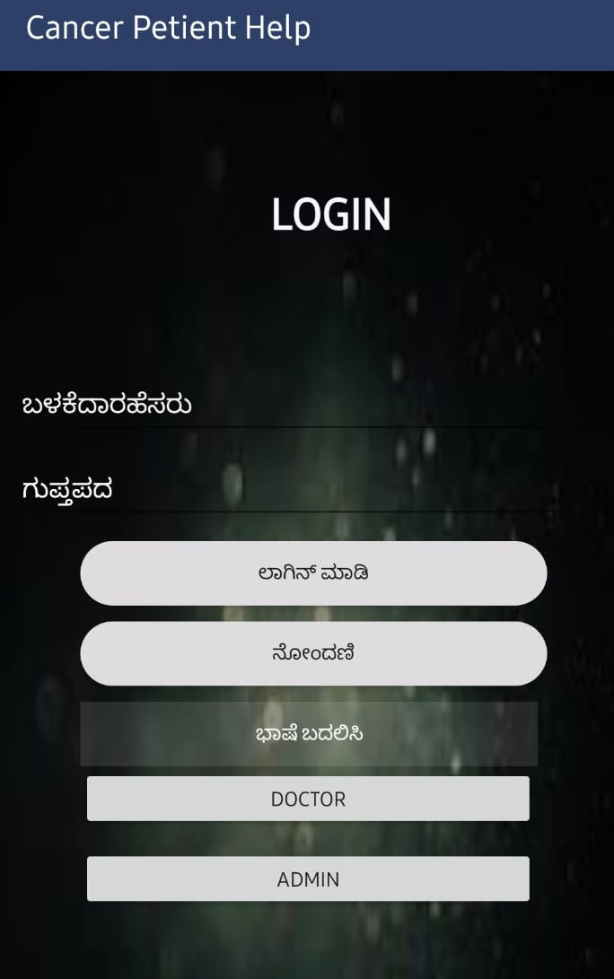
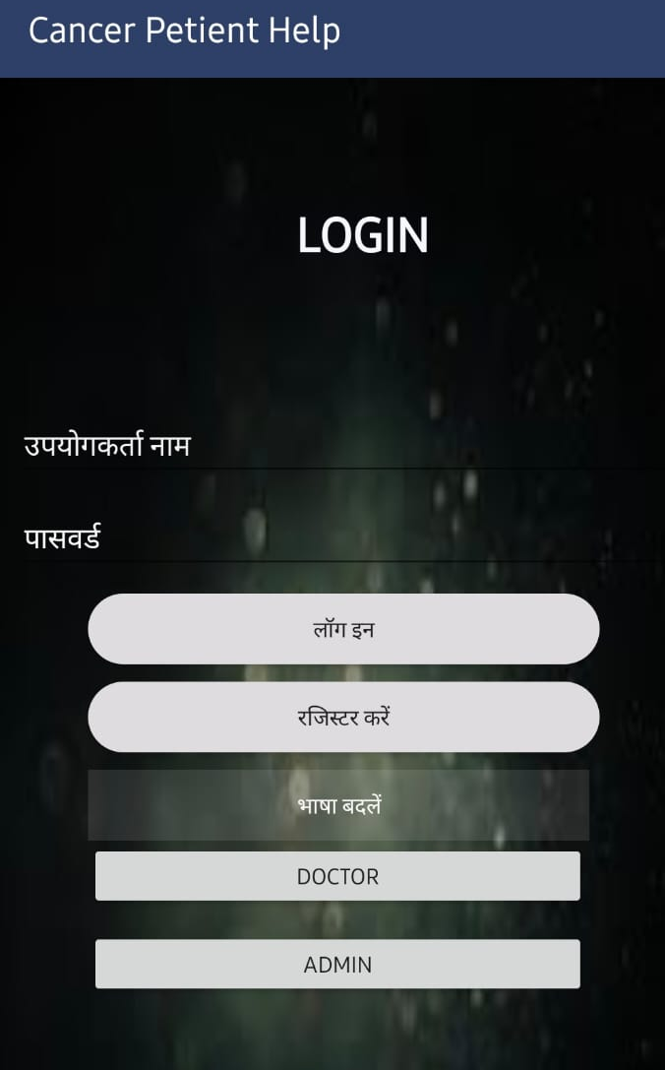
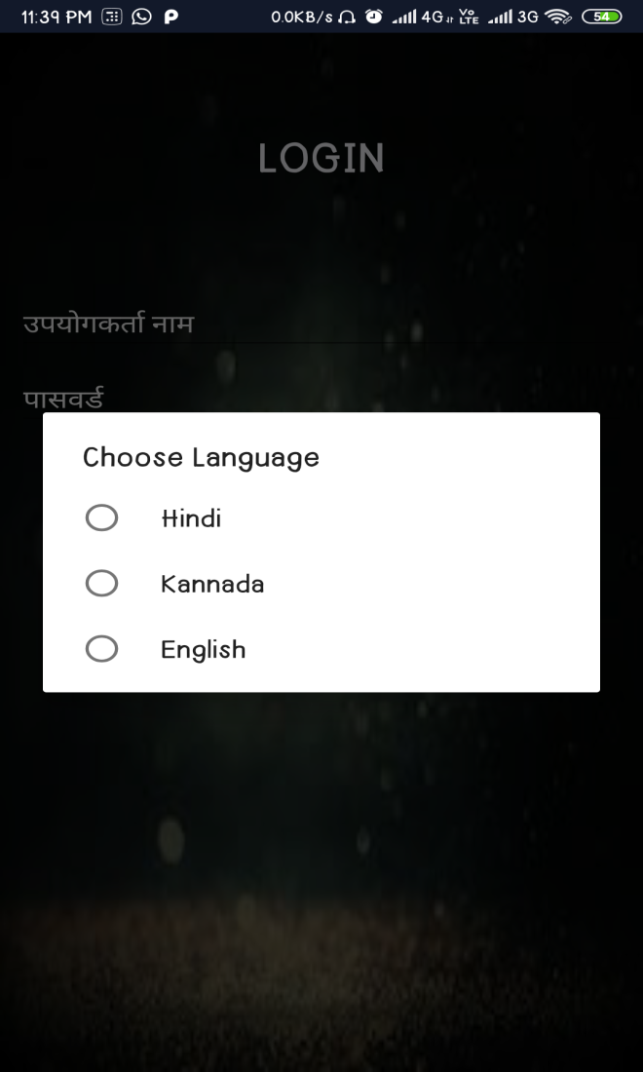
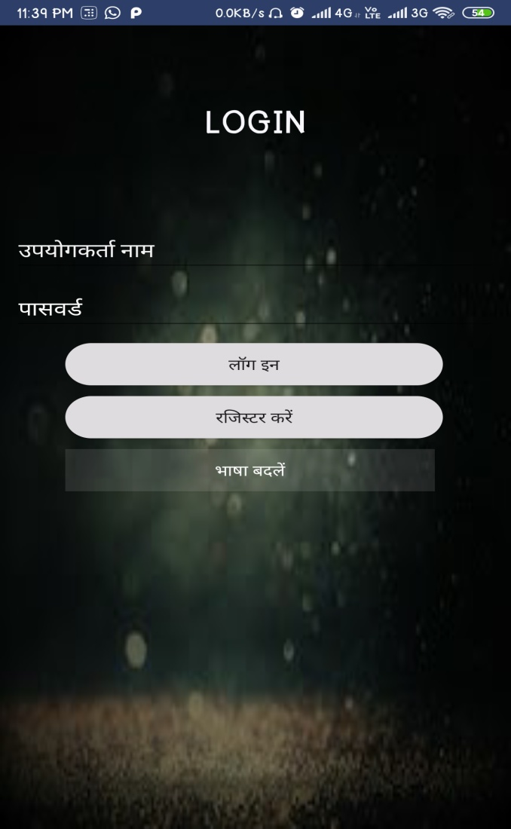
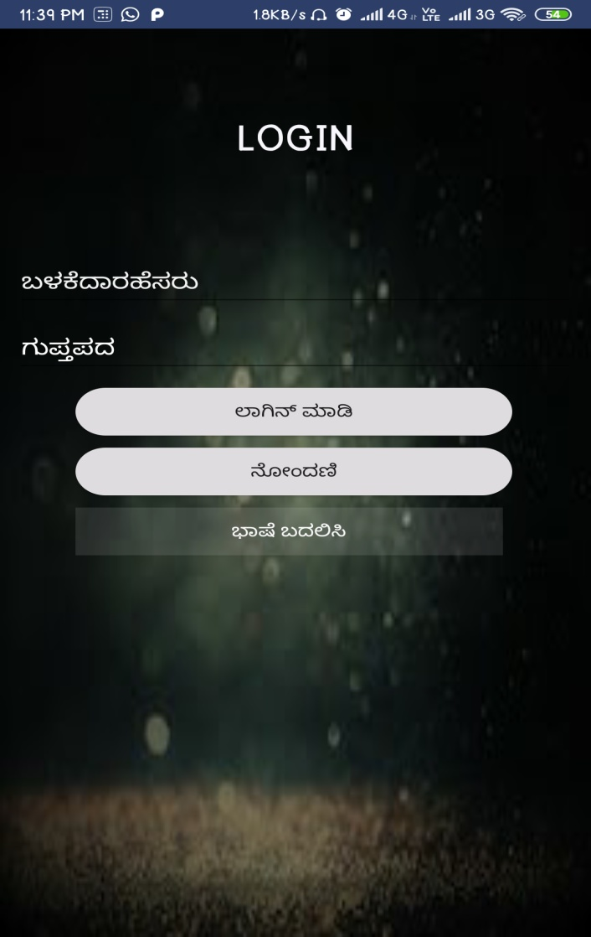
Contd. :

Slide 14
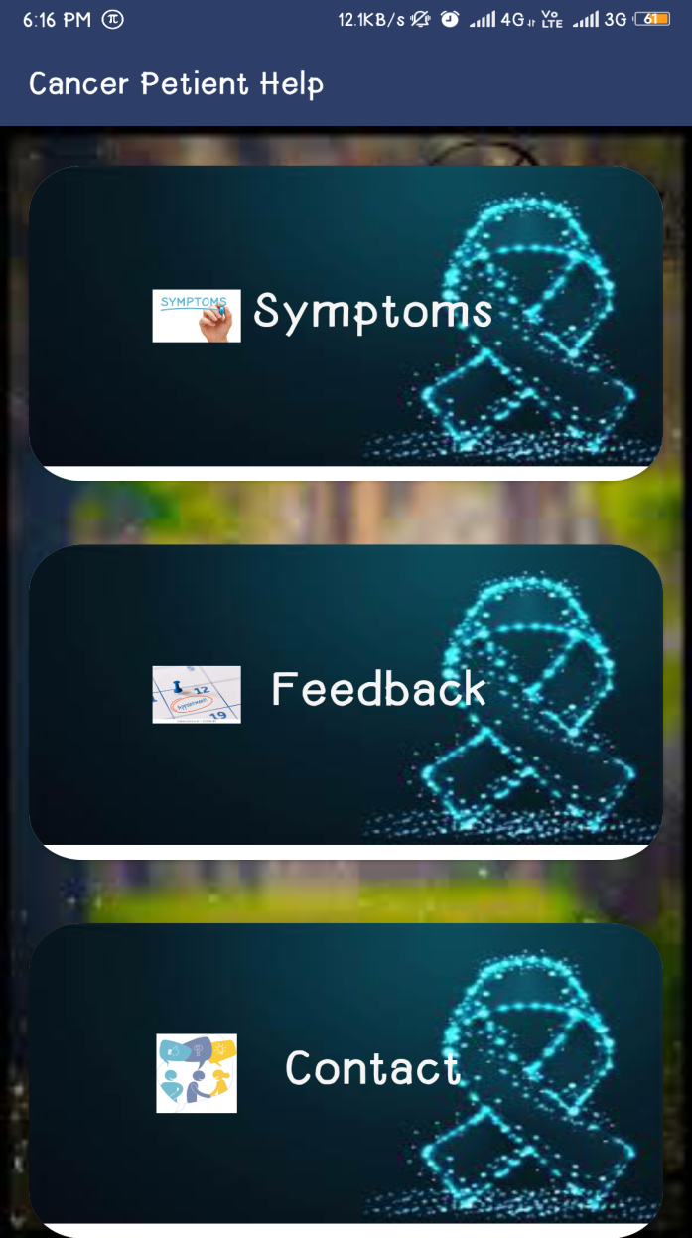
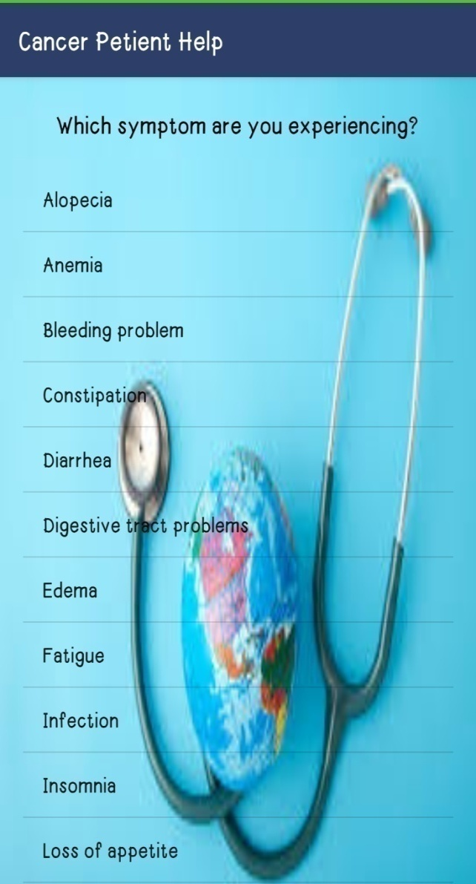
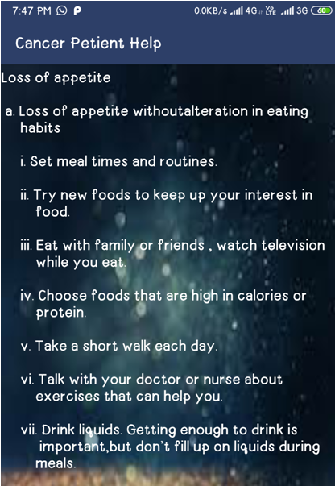
Contd. :

Slide 15
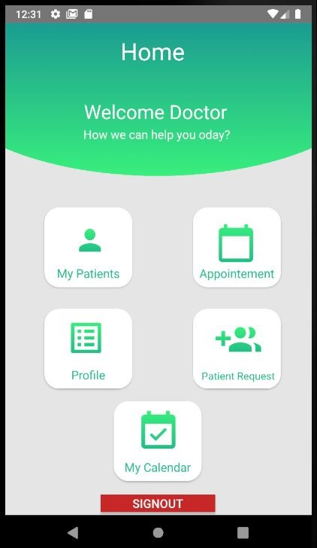
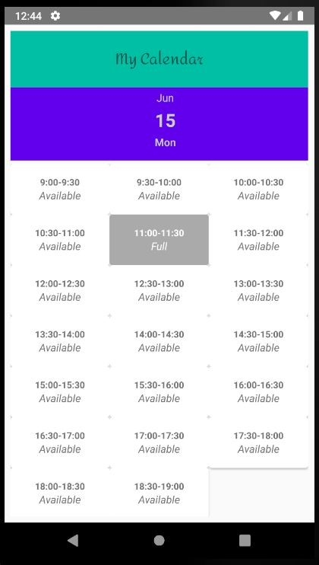
Contd. :

Slide 16
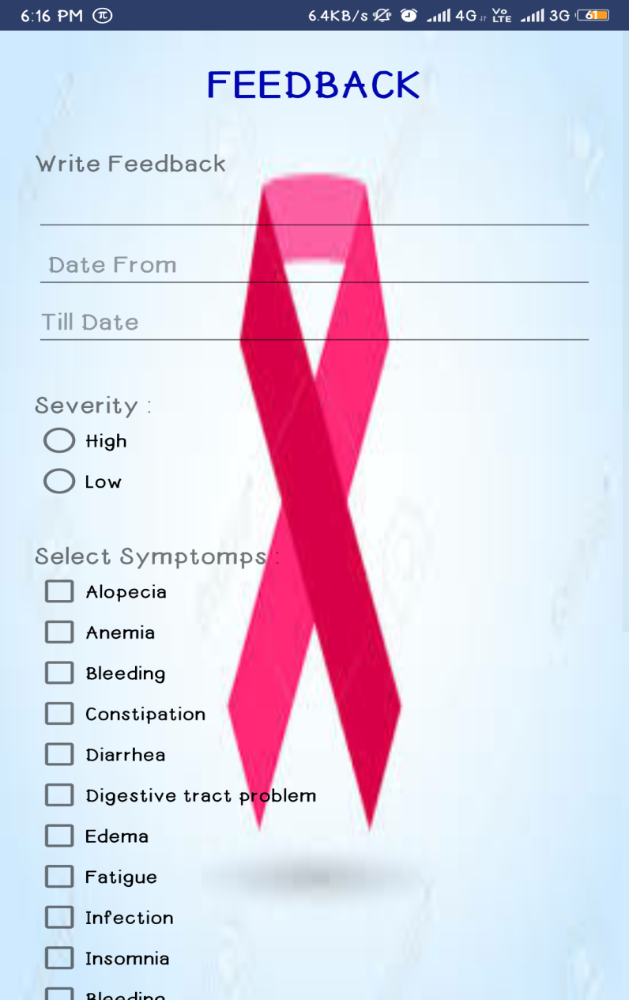
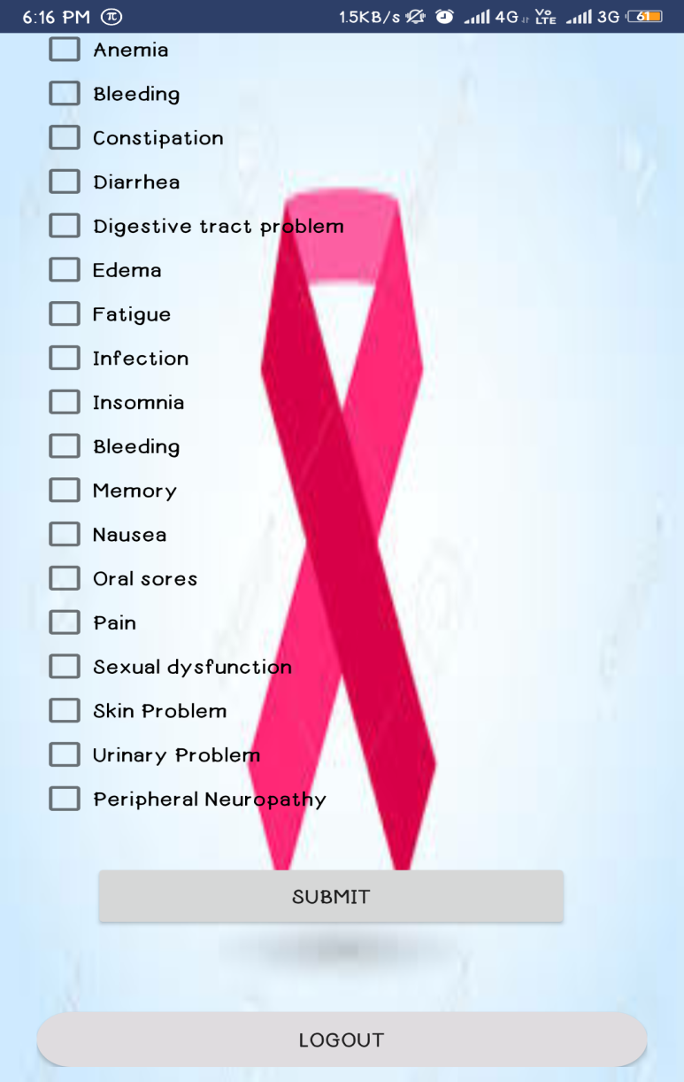
Contd. :

Slide 17
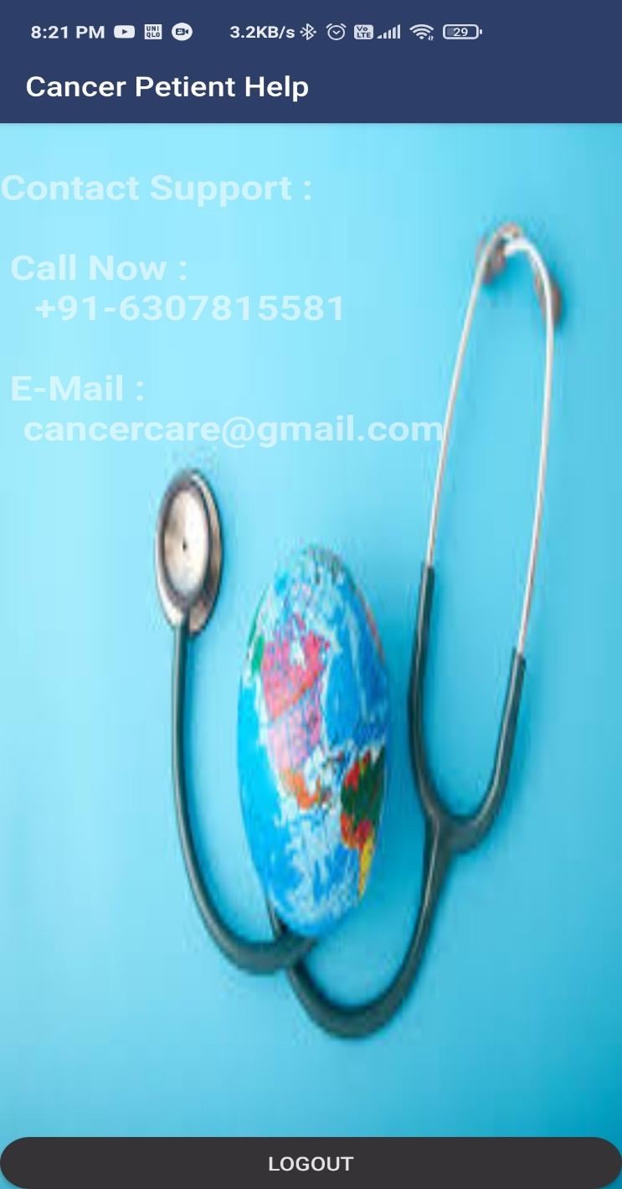
Contd. :

Slide 18
CONCLUSION :
This health care application, helps user to know the symptoms at initial stage and can take necessary precaution against it.
And helps users to get the instant information and precautions about the particular symptoms.
Helps the doctor to keep track the precautions followed by the patients.

Slide 19
Future Scope
Synchronization between web and android application
Providing more functionality to users
Implementation change language facility to all other pages as well.

Slide 20
Reference :
https://cancer.net/navigating-cancer-care/managing-your-care/mobile-applications
https://www.postgresql.org/docs/8.0/tutorial.html
https://developer.android.com/reference/androidx/classes

